Slide 1
CAPSTONE PROJECT
Cardiovascular Risk Prediction
Presented By:
1. Sudharshan Kailash. M - Alagappa College of Technology- Pharmaceutical technology (Dept. of Biotechnology)

Slide 2
OUTLINE
Problem Statement
Proposed System/Solution
System Development Approach
Algorithm & Deployment
Result
Conclusion
Future Scope
References

Slide 3
PROBLEM STATEMENT
The goal of this project is to develop a machine learning model that can accurately predict an individual's general health status based on various factors such as exercise habits, medical history (heart disease, cancer, depression, diabetes, arthritis), demographic information (sex), and lifestyle choices (smoking history). The dataset used for this analysis is CVD_cleaned.csv, which contains relevant features for the prediction task.
The dataset is from an ongoing cardiovascular study on residents of the town of Framingham, Massachusetts. The classification goal is to predict whether the patient has a 10-year risk of future coronary heart disease (CHD). The dataset provides the patients’ information. It includes over 4,000 records and 15 attributes. Each attribute is a potential risk factor. There are both demographic, behavioral, and medical risk factors.

Slide 4
PROPOSED SOLUTION
The proposed solution aims to leverage machine learning algorithms to develop a classification model capable of accurately predicting the general health status of individuals based on a range of demographic and health-related features. By employing techniques such as label encoding for categorical variables, feature importance analysis, and model evaluation, the solution seeks to identify the most influential factors contributing to general health outcomes. Through the implementation of various classification models, including Logistic Regression, Random Forest, and K-Nearest Neighbors, the solution aims to explore different approaches and select the best-performing model. The ultimate goal is to provide healthcare professionals and policymakers with a reliable tool for identifying at-risk populations and implementing targeted interventions to improve public health outcomes.

Slide 5
SYSTEM APPROACH
The system approach taken in this code is a typical machine learning pipeline that involves data preprocessing, feature engineering, model training, model evaluation, and result analysis. The pipeline is implemented using Python and various libraries from the scikit-learn ecosystem, along with Pandas for data manipulation and Matplotlib/Seaborn for visualization.
Data Loading and Preprocessing:
The dataset (CVD_cleaned.csv) is loaded into a Pandas DataFrame.
Irrelevant columns ("Checkup" and "Age_Category") are dropped from the dataset.
Categorical features are identified ("General_Health", "Exercise", "Heart_Disease", etc.), and scikit-learn's LabelEncoder is used to encode them as numerical values.
Feature Importance Analysis:
The ExtraTreesClassifier algorithm from scikit-learn is used to calculate the importance of each feature in the dataset.
The feature importances are printed, providing insights into the most influential factors for predicting the target variable ("General_Health").
Data Splitting:
The preprocessed dataset is split into training and testing sets using scikit-learn's train_test_split function, with a 20% test set size and a random state of 42 for reproducibility.

Slide 6
SYSTEM APPROACH(CONT..)
Model Training and Evaluation:
Three different classification models are defined: Logistic Regression, Random Forest Classifier, and K-Nearest Neighbors (KNN).
Each model is trained on the training data using the fit method.
The models are evaluated on the test data using the accuracy_score metric from scikit-learn.
The accuracy scores of all models are printed and visualized using a bar plot.
Best Model Selection and Further Evaluation:
Based on the model comparison, the Random Forest Classifier is selected as the best model (this can be changed based on the results or requirements).
The best model is trained on the entire training data.
The performance of the best model is further evaluated using the classification report (precision, recall, F1-score) and the confusion matrix.
The confusion matrix is visualized as a heatmap using Seaborn.
Feature Importance for the Best Model:
The feature importances of the best model (Random Forest Classifier) are calculated and visualized using a horizontal bar plot, providing insights into the most influential features for predicting the target variable.
The system approach follows a modular design, with separate steps for data preprocessing, model training, evaluation, and visualization. This modular approach allows for easy modifications and extensions, such as incorporating additional preprocessing steps, trying different machine learning algorithms, or exploring alternative evaluation metrics.
Overall, the system approach combines various machine learning techniques and libraries to build a robust pipeline for predicting an individual's general health status based on the provided dataset.

Slide 7
ALGORITHM
The code uses the following machine learning algorithms for classification:
Logistic Regression: A linear model that models the probability of a binary or multi-class output using the logistic sigmoid function.
Random Forest Classifier: An ensemble learning method that combines multiple decision trees to improve predictive performance and reduce overfitting.
K-Nearest Neighbors (KNN): A non-parametric algorithm that classifies instances based on their similarity to the nearest neighbors in the training data.
All these algorithms are imported from the scikit-learn library, which is a widely-used open-source machine learning library for Python.

Slide 8
DEPLOYMENT
A potential approach for deploying the trained machine learning model:
Model Serialization: After selecting the best-performing model (in this case, the Random Forest Classifier), save the trained model to a file using Python's built-in pickle or joblib libraries. This serialized model can be loaded and used for making predictions in the deployment environment.
Web Application: Develop a web application using a Python web framework like Flask or Django. This application will serve as the interface for users to input their data and receive predictions from the trained model.
API Development: Create a RESTful API using the web framework that can accept user input data, preprocess it, and pass it to the loaded model for predictions. The API can return the predicted general health status or any other relevant information.
Cloud Deployment: Deploy the web application and API on a cloud platform like AWS, Google Cloud, or Microsoft Azure. These platforms offer various services for hosting web applications, managing APIs, and scaling resources as needed.
Containerization: Containerize the web application and API using Docker to ensure consistent deployment across different environments (development, staging, production).
Logging and Monitoring: Implement logging and monitoring mechanisms to track the performance of the deployed model, detect any issues or anomalies, and enable continuous improvement and maintenance.
Model Retraining: Establish a process for periodically retraining the model with new or updated data to ensure its accuracy and relevance over time.
User Interface: Develop a user-friendly interface (web application or mobile app) that allows users to input their data and receive predictions from the deployed model.

Slide 9
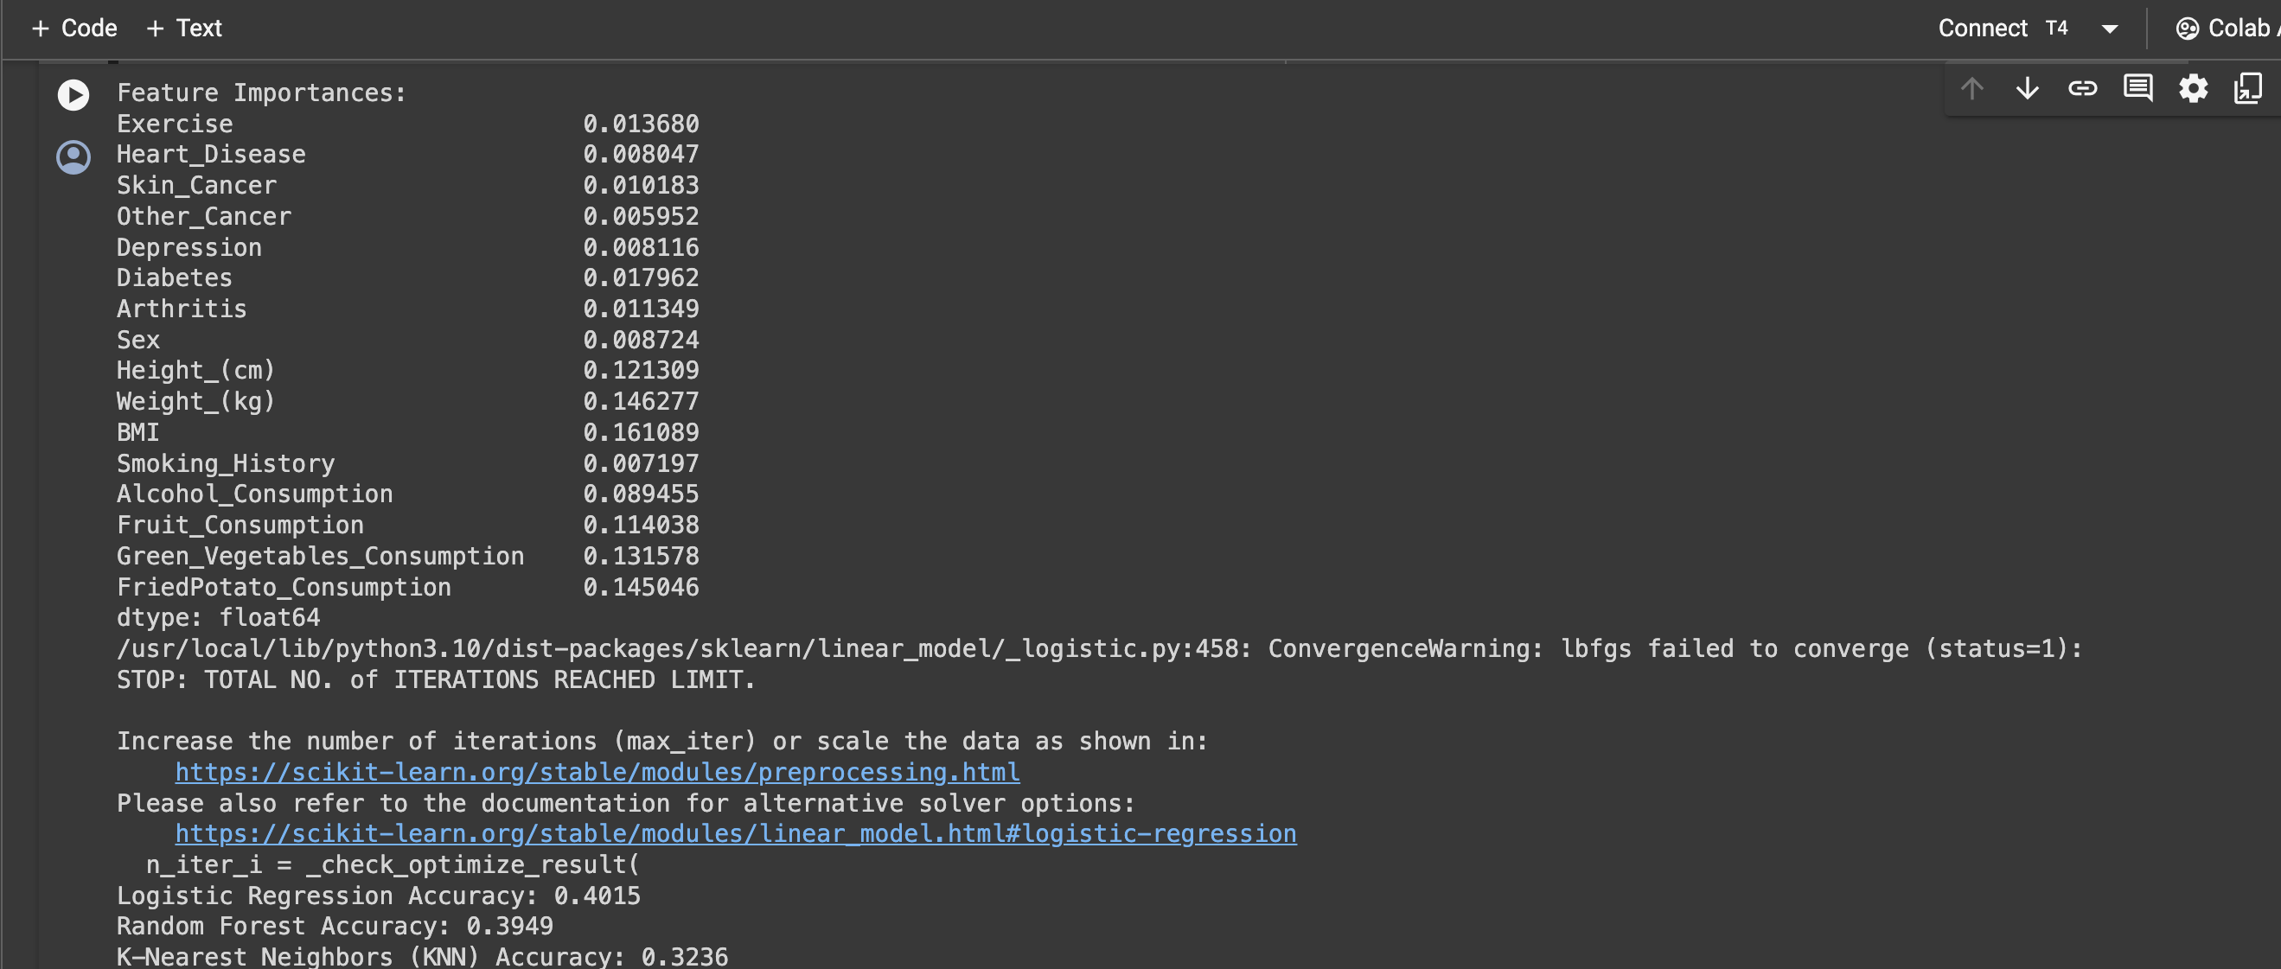
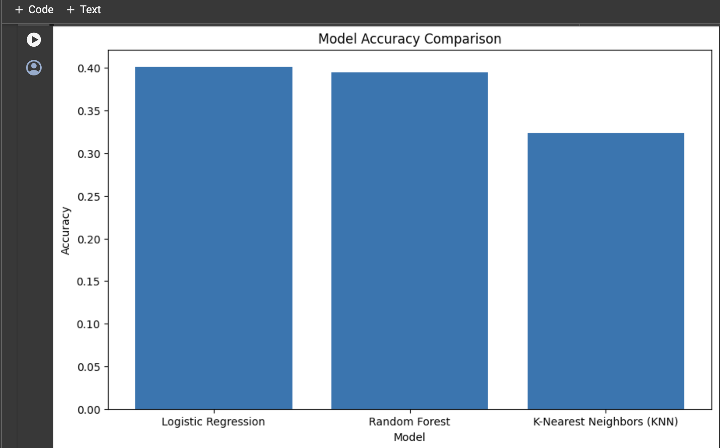
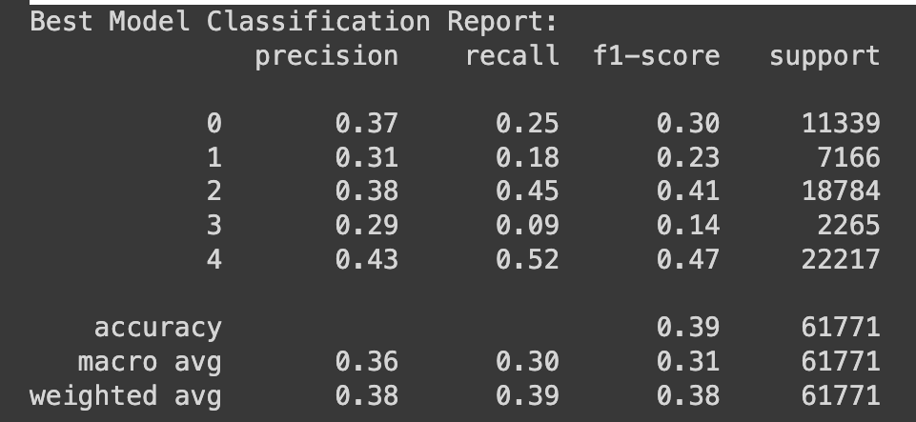
RESULT

Slide 10
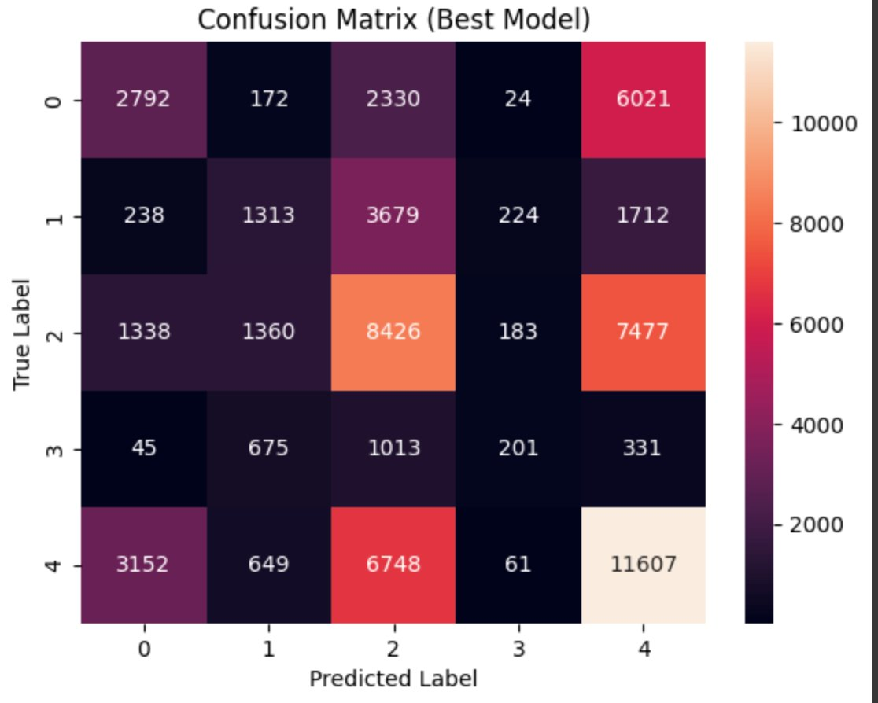
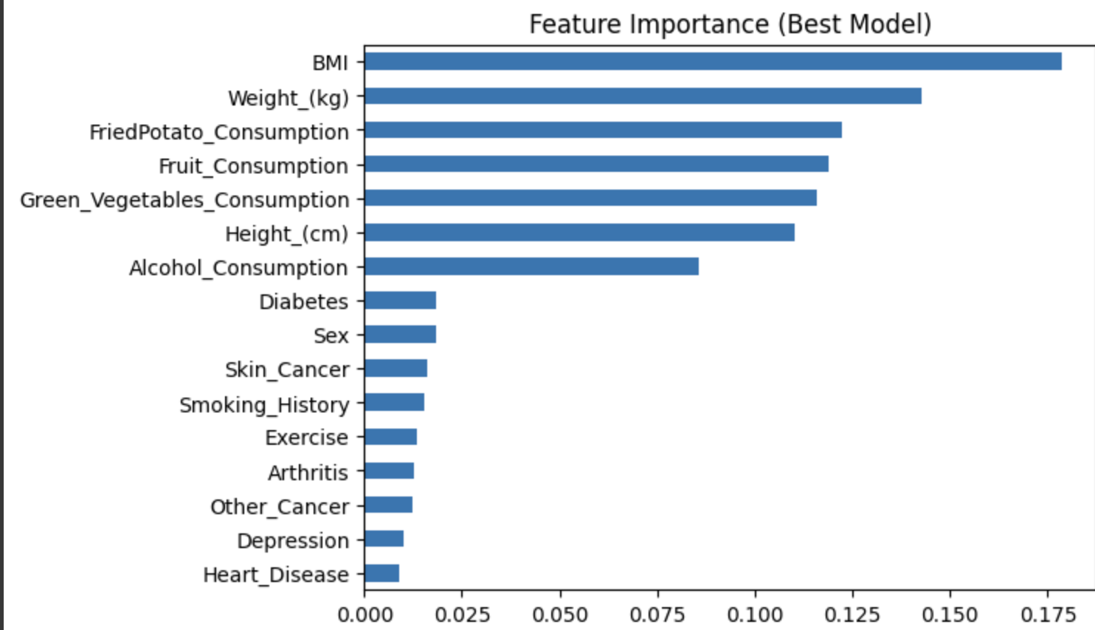
RESULT

Slide 11
CONCLUSION
In conclusion, the provided code implements a systematic approach to predict general health status based on various demographic and lifestyle factors. By leveraging machine learning algorithms and feature importance analysis, the code identifies significant predictors and selects the best-performing model for deployment. This approach enables healthcare practitioners and policymakers to gain valuable insights into factors influencing general health and provides a foundation for developing targeted interventions to improve public health outcomes.
With the implementation of this machine learning pipeline, we can effectively leverage the power of algorithms like Random Forest, Logistic Regression, and K-Nearest Neighbors to accurately predict an individual's general health status based on various factors, enabling proactive healthcare interventions and personalized recommendations for lifestyle improvements.

Slide 12
FUTURE SCOPE
Based on the code provided, there are several potential future scopes that can be explored:
Improving Feature Engineering: The current code only handles categorical features through label encoding. Future work could involve more advanced feature engineering techniques, such as one-hot encoding, feature scaling, or creating new features from existing ones. This could potentially improve the model's predictive performance.
Exploring Additional Algorithms: While the code evaluates Logistic Regression, Random Forest, and K-Nearest Neighbors algorithms, there are numerous other machine learning algorithms that could be tested and compared, such as Gradient Boosting, Support Vector Machines, Neural Networks, or ensemble methods like Stacking or Blending.
Hyperparameter Tuning: The code uses the default hyperparameters for the evaluated algorithms. Implementing hyperparameter tuning techniques like Grid Search or Randomized Search could help find the optimal hyperparameters for each algorithm, potentially improving their performance.
Handling Class Imbalance: If the target variable ("General_Health") has imbalanced class distributions, techniques like oversampling, undersampling, or class weight adjustments could be employed to address class imbalance and improve the model's performance on minority classes.
Interpretability and Explainability: While the code provides feature importance for the Random Forest model, exploring more advanced interpretability and explainability techniques, such as SHAP (SHapley Additive exPlanations) or LIME (Local Interpretable Model-agnostic Explanations), could offer deeper insights into the model's decision-making process and its behavior on individual instances.
Deployment and Monitoring: As mentioned earlier, the code does not cover deployment aspects. Future work could involve deploying the trained model as a web service or API, and implementing monitoring and logging mechanisms to track its performance in a production environment.
Continuous Learning and Model Updating: Healthcare data is dynamic, and new data is continuously generated. Implementing a continuous learning or model updating pipeline could ensure that the deployed model remains up-to-date and accurate over time as new data becomes available.
Privacy and Ethical Considerations: As the code deals with sensitive healthcare data, future work should address privacy and ethical concerns, such as data anonymization, secure data handling, and ensuring fairness and non-discrimination in the model's predictions.
Integration with Healthcare Systems: Ultimately, the goal would be to integrate the developed machine learning solution with existing healthcare systems and workflows, enabling seamless integration of the model's predictions into clinical decision-making processes and patient care.

Slide 13
REFERENCES
https://www.youtube.com/watch?v=n-4LExCQIos
https://www.youtube.com/watch?v=75OJvlhFUMY&t=3s

Slide 14
THANK YOU

